Slide 1
FOR THE BETTER WORLD…..
TERTIARY ROADS
By,
Yogesh S Bellad
Yashswini D
Yogesh Babu S
Shreyas J Kumar

Slide 2
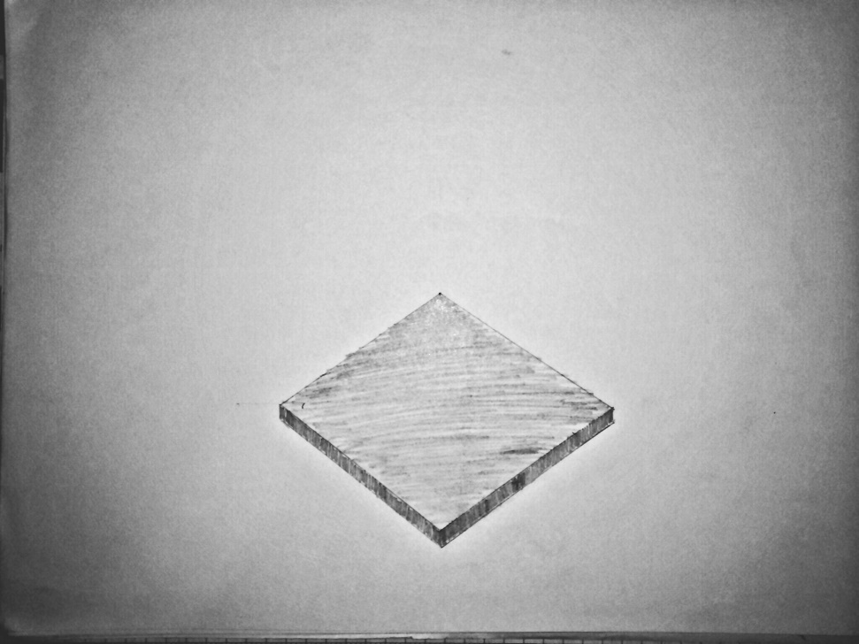
Base

Slide 3
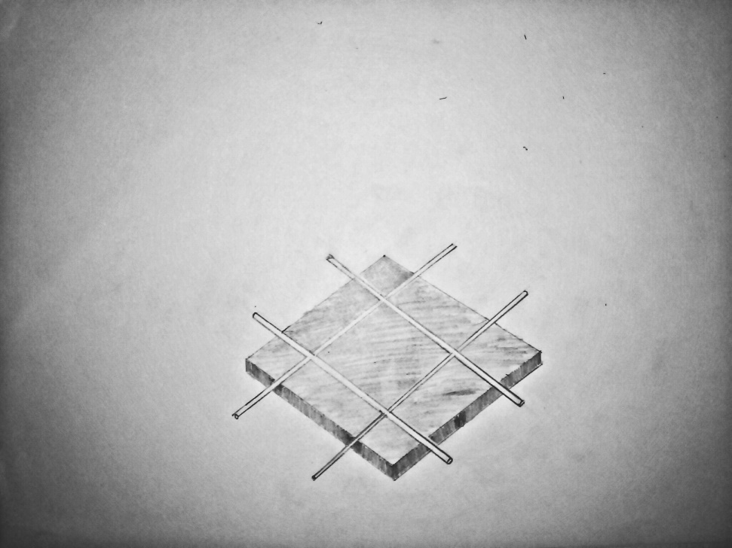

Interconnection
Simple ‘#’ shaped connection.
No open circuit created when a cell fails.
Copper wires used.

Slide 4
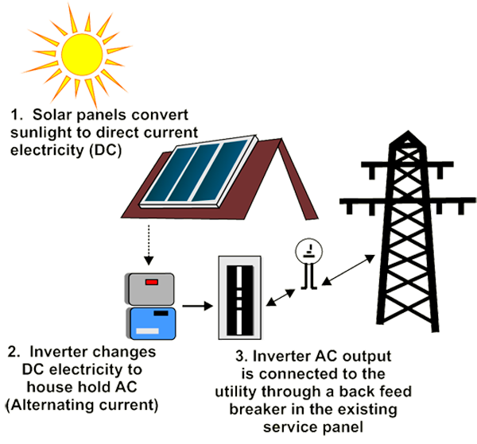
Solar cell
Power generated by cells is connected to on laying power grid of city electricity board.
Generated electricity is also used to power the LEDs embedded in the cells

Slide 5

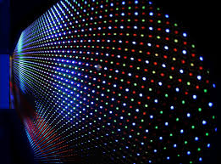
LED
They are embedded in each solar cell.
Are connected in a similar fashion as the solar cells.
Used for traffic signals and for ambulance free path lane.

Slide 6




Usage of LEDs
Clearing lanes when an ambulance comes as seen.
Also in a similar manner density controlled traffic signals with RYG LEDs that glow at corresponding time intervals.

Slide 7
Advantages of LED
Low power consumption.
Less expensive.
Available in different colors for different purposes.
Can be manufactured at higher numbers.

Slide 8
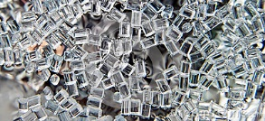
Polymer coating

Slide 9
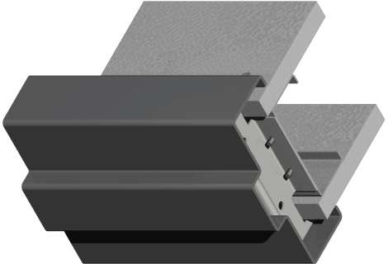
Interlocking frames
These hold the solar cell blocks together.

Slide 10
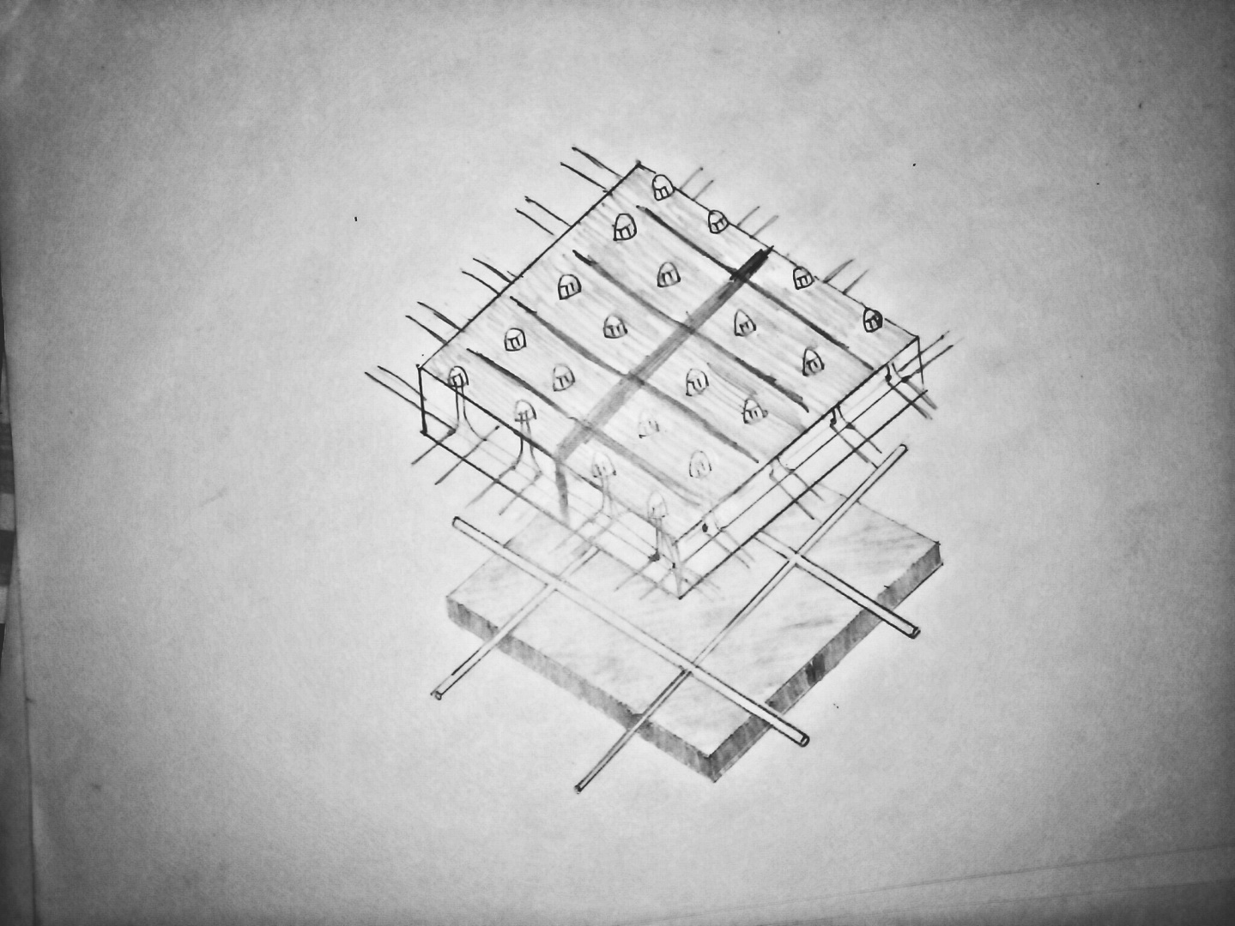

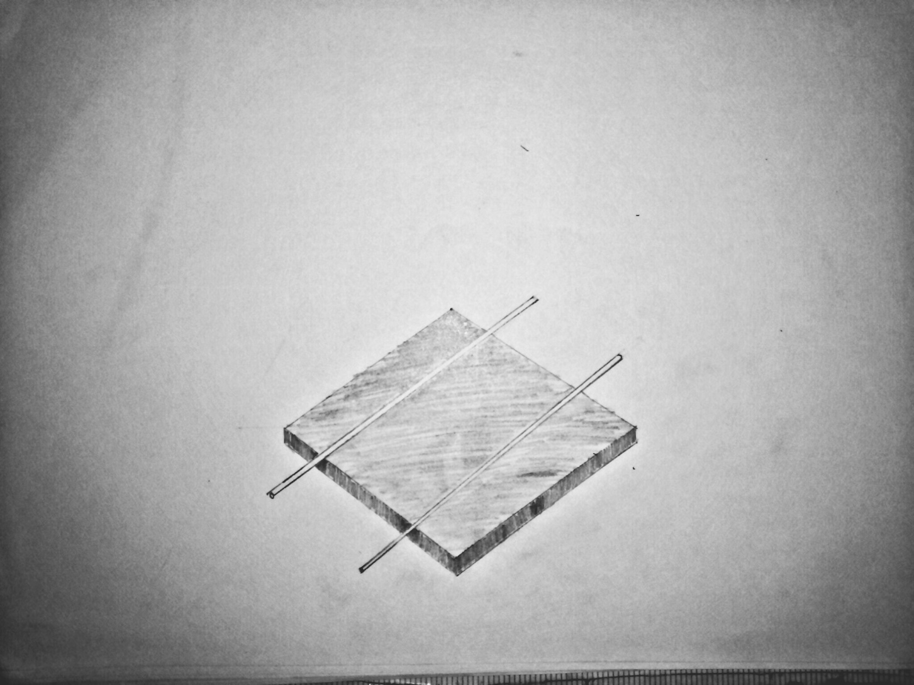
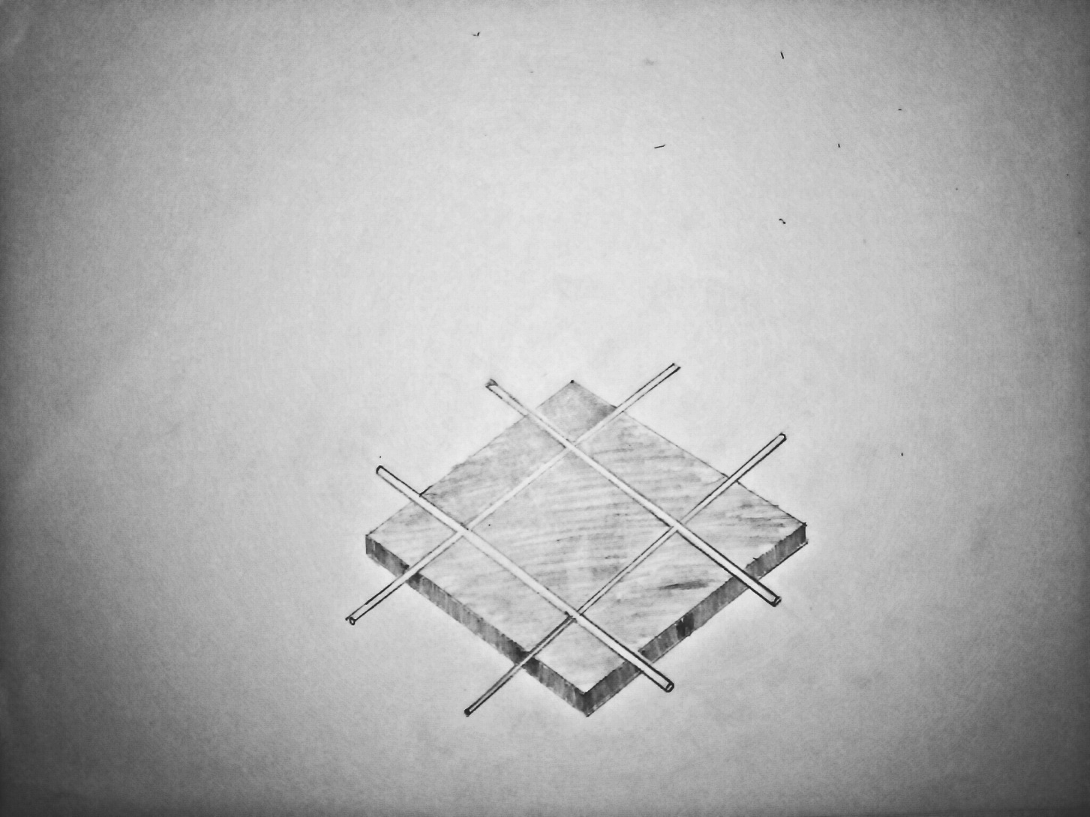
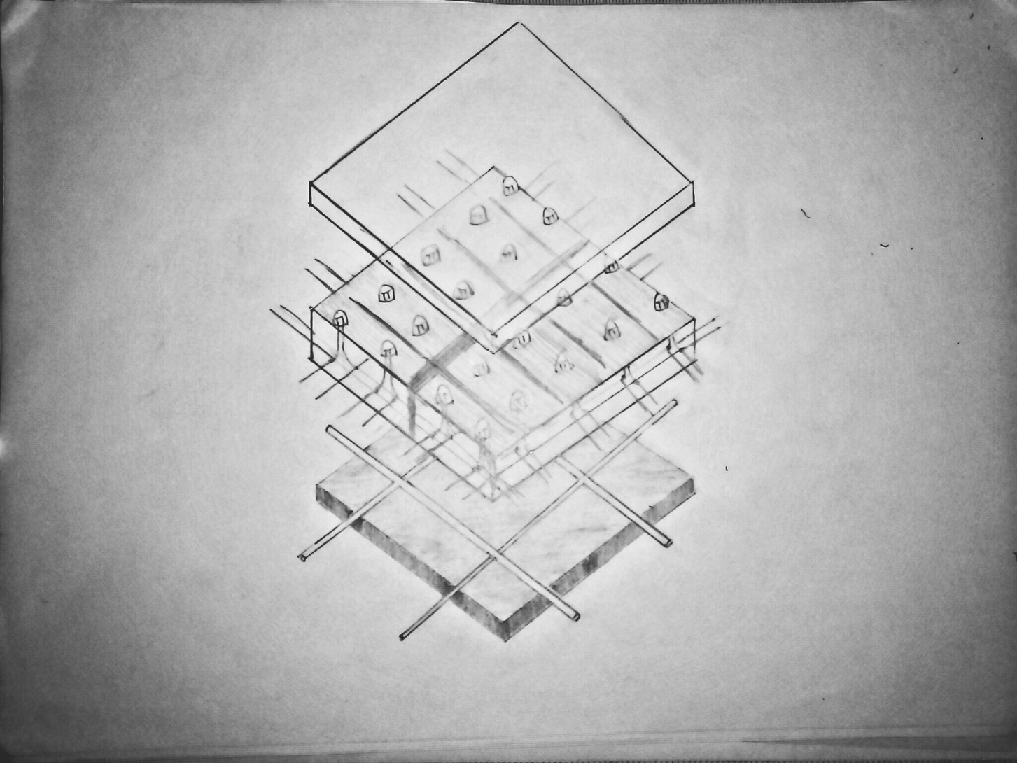
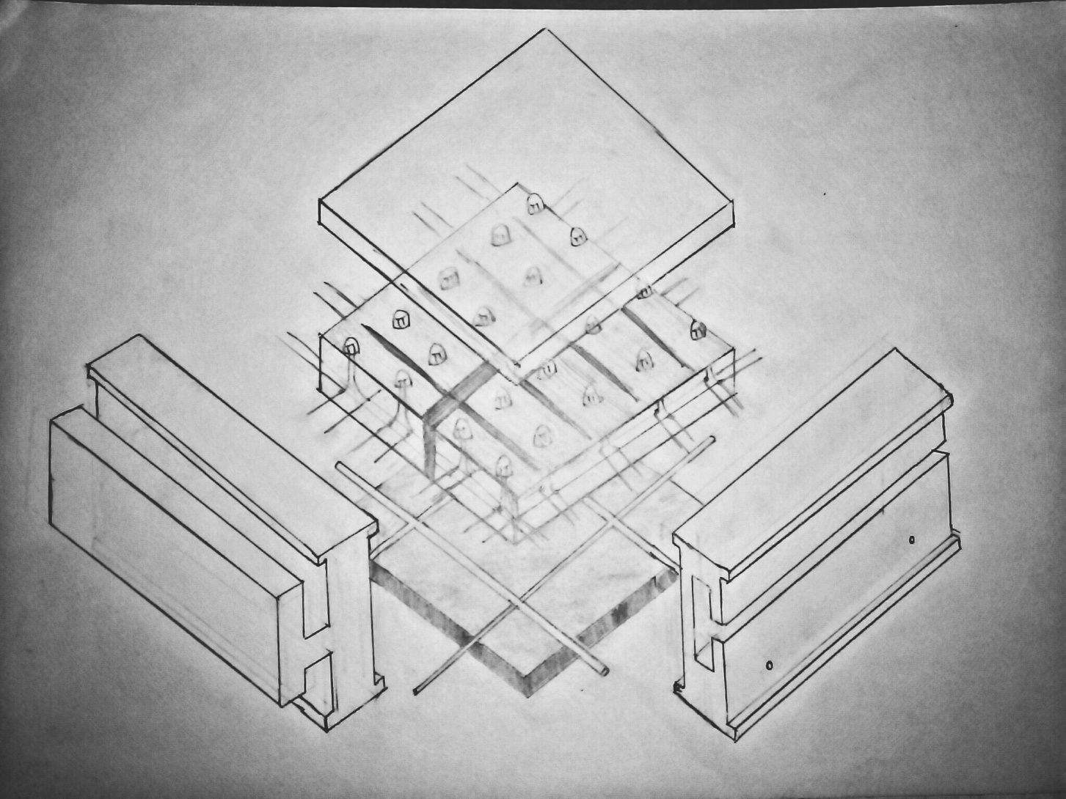
Final structure of the solar cell

Slide 11


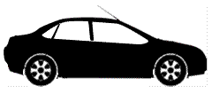
Traffic box[TBx]
A small unit installed in every vechicle.
Contains a locator,memory unit, GPS tracking unit, etc..
TBx
Locator
Memory
GPS
…
...
TBx
TBx
TBx

Slide 12
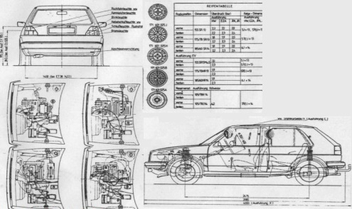
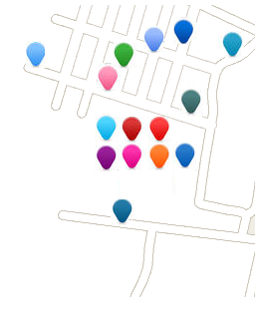
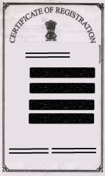

Advantages of installing TBx
Pin points location every vehicle.
Memory in every TBx stores- 1) Vehicle Specifications
2) Registration Certificate
3) Driver’s details
Thus we can learn status of every vehicle

Slide 13
Benefit to Authority
Reduction in -
1) Vehicle Identification Scams.
2) Vehicle Theft Complaint.
3) Need of multiple Policemen.
Driver can be fined for breaking traffic rules easily with proof.
Instantaneous status of vehicle & history of vehicle.
(if records are maintained)
Vehicle Surveys are easier and more accurate.
TBx
Locator
Memory

Slide 14
Extensions (Pros for owner)
GPS Navigation System.
AV Player + mobile phone integrator.
Violation SMS alert.
Avoid unnecessary fine as TBx can have data.
(e.g.: No Parking area , 1 way ,Speed limit ,etc…)
Security :
1) License scanner which could be used as power key.
2) Anti Theft.

Slide 15
Surprise Facts
Data communication
-in unused lower generation Spectrum (2G).
Actually could eradicate concept of number plates.
Bribing policemen also taken care.
Simple procedure of installation & usage.
Accidents are reduced.
Driver can be alerted by emergency vehicle.
Traffic Reduces & transport speed increases.

